Slide 1
Operating Cycle and Cash Conversion Cycle
Presented by [Name]

Slide 2
Operating and Cash conversion Cycle
The time that elapses between the purchase of raw materials and the collection of cash for sales is referred to as the operating cycle,
whereas the time length between the payment for raw material purchases and the collection of cash for sales is referred to as the cash cycle.

Slide 3
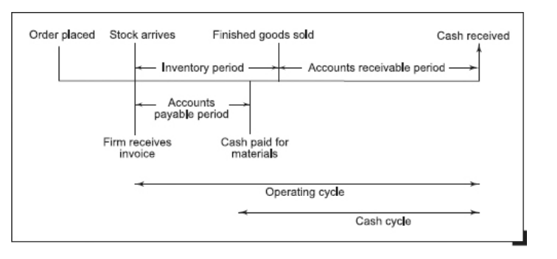
Conti…

Slide 4
Conti..
Operating Cycle= Inventory Period + Account Receivable Period
Cash Conversion Cycle= Inventory Period + Account Receivable Period-Accounts Payable Period

Slide 5
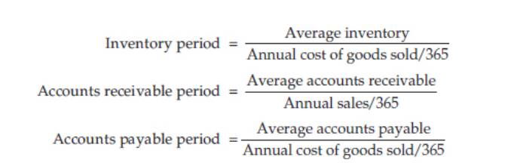
Conti..

Slide 6
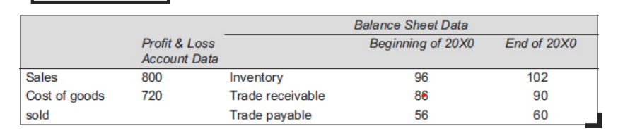
Example

Slide 7
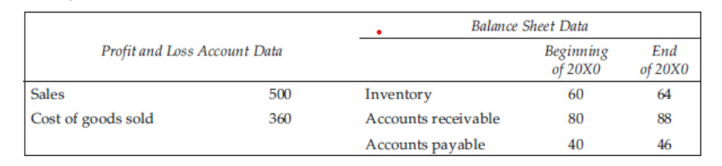
Example

